Slide 1
Introduction to SharePoint 2013 App Model
Speaker name
Title
Microsoft corporation

Slide 2
Agenda
Why Apps?
Introducing the new SharePoint 2013 App Model
App Model Architecture Overview
App Hosting Models
Development Process
App User Experience

Slide 3
Why Apps?

Slide 4
Sites, People, Apps, and Themes
SharePoint is complicated with many concepts and artifacts
Pages
Lists
Libraries
Sites
Views
Web Parts
Master Pages
etc, etc, etc
Notes:
From a technical perspective, SharePoint has many concepts and artifacts to learn and use.
The number of concepts and artifacts makes SharePoint difficult to learn. End users are often confused by the number of available elements appearing in the ribbon and navigation.
The SharePoint experience is different from other many web applications that are dedicated to single purposes. Amazon is for sales, eBay is for auctions, but SharePoint has many purposes.
Within this array of concepts and artifacts, we have found that end users primarily understand only 4: Sites, People, Apps, and Themes
So we want to center the SharePoint experience on these concepts. When we create apps for SharePoint, we want to be aware of these concepts.

Slide 5
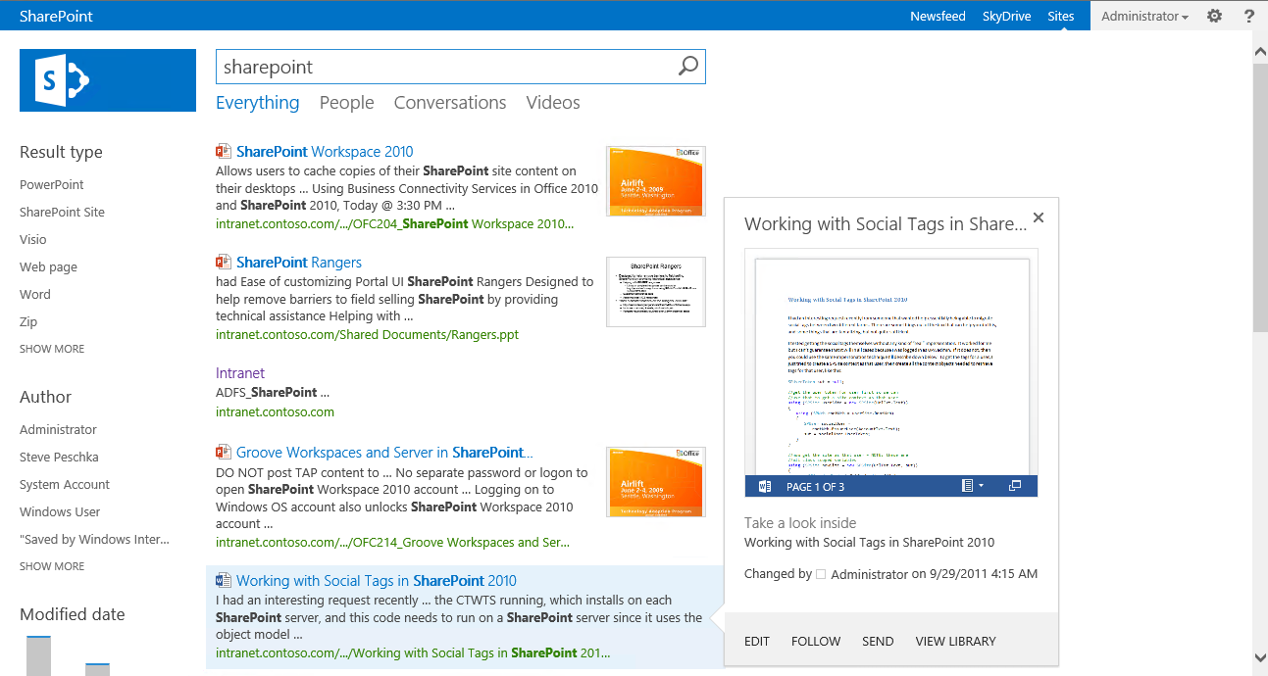
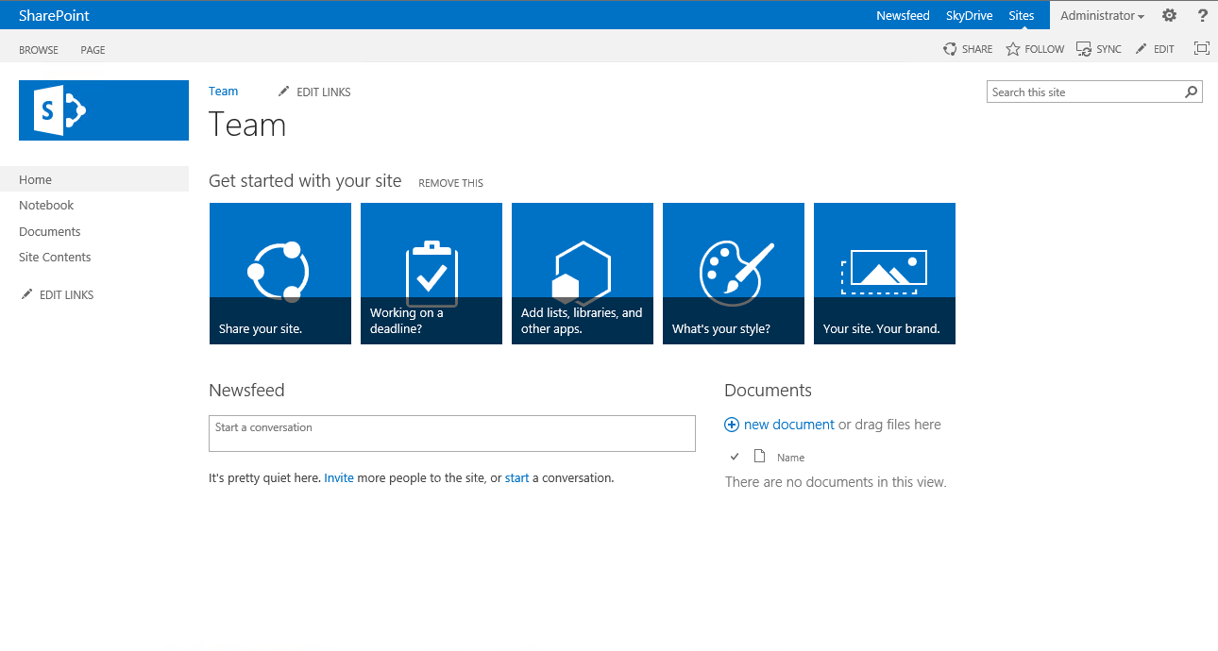
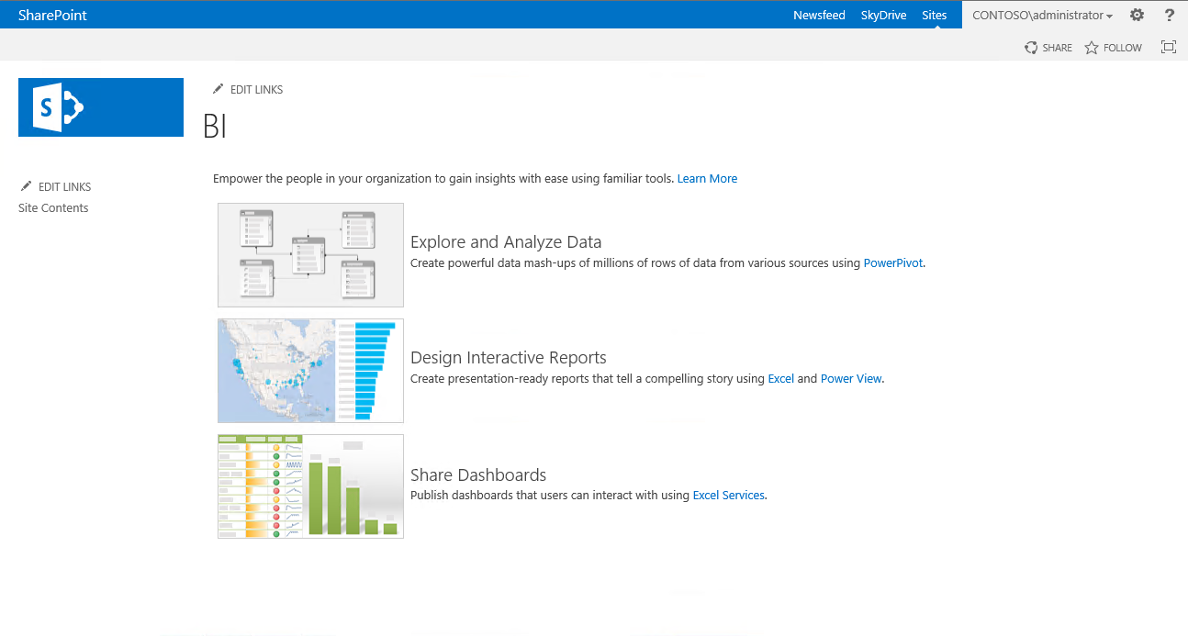
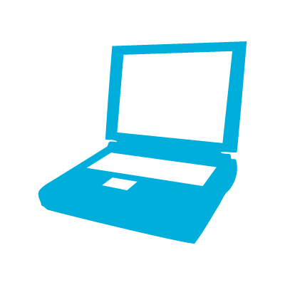
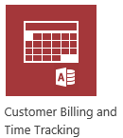

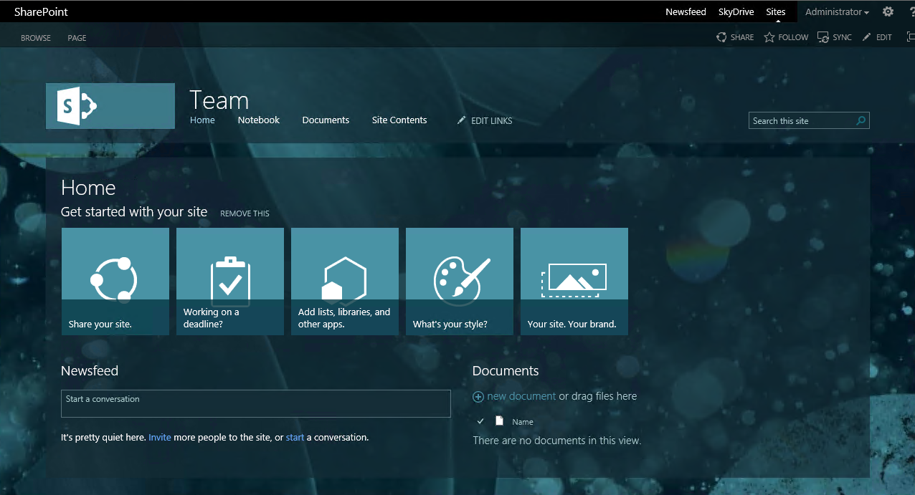

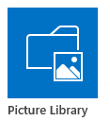
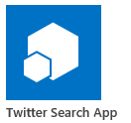
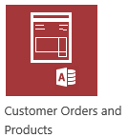
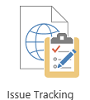
Sites, People, Apps, and Themes
Sites
Members (people)
Apps
Themes

Slide 6
Sites, People, Apps, and Themes
What Does SharePoint Have today?
Sites
Team Sites
My Sites
People
Profiles
My Sites
Themes
Site Theming
Notes:
In SharePoint 2010 and prior, SharePoint had 3 of the 4 concepts available out of the box. We really didn’t have a concept of Apps, but end users are increasingly aware of the app concept through things like smart phones.
Apps are a critical part of the experience. Yes, we have concepts that are app-like (workflow, lists, libraries) but not truly Apps which are built to perform specific functions similar to the way they are in phones and tablets. This is the gap that needs to be filled.
Aside from the end-user perspective, Apps fill a technical need as well. There have been big issues with fully-trusted applications. They can destabilize the farm; they are difficult to migrate to new versions of SharePoint.
The initial attempt to solve this problem was sandboxed solutions. The problem with sandboxed solutions is that they were very limiting.

Slide 7
SharePoint 2010 Application Challenges
Custom code on server
Root cause of most SharePoint outages / issues
Lots to deploy
Requires a big server touch
Not possible in hosted environments
Sandbox
Possible in hosted environment
Limited set of things you can do
In both, developers must know SharePoint API
Notes:
Traditional SharePoint development required employing SharePoint solution packages either as sandbox (aka: partially trusted) solutions or farm (full-trust) solutions. These involved putting custom code on the server.
For farm solutions this meant you had a big server touch and could potentially cause site outages if the code did not perform well or was defective.
Sandbox solutions addressed these concerns by allowing site collection owners to deploy code to the server through the browser, but this added flexibility came with the cost that you could not do everything possible in a farm solution.
Both sandbox and farm solution development required the developer to have a firm grasp of the SharePoint API.

Slide 8
Introducing the Cloud App Model for new SharePoint

Slide 9
Introducing SharePoint App Model
SharePoint applications no longer live in SharePoint
Custom code executes in the client, cloud or on-prem
Apps are granted permissions to SharePoint via OAuth
Apps communicate with SharePoint via REST / CSOM
Acquire apps via centralized Marketplace
Corporate Marketplace
Public Marketplace (via submission process)
APIs for manual deployment
Notes:
The new SharePoint app model is designed to not only address issues around the solution package approach to SharePoint customization, but also to introduce new capabilities. SharePoint apps do not live in SharePoint, rather they execute in the browser client or on a non-SharePoint server such as an IIS server or in the cloud. Apps are granted permission into SharePoint sites via OAuth and communicate over the new investments in the REST and CSOM APIs.
Developers will be able to publish their apps to a public marketplace for download & purchases. In addition organizations will be able to create a private corporate marketplace where the apps would be available to the organization.

Slide 10
App Principles
Apps are a very different philosophical change to extending SharePoint
More scenario-focused
Event Tracking
Ticket Management System
Robust
Built-in robust semantics for install, upgrade & uninstall
Apps are for End Users
Cloud & Web-Oriented
Notes:
Apps introduce a breaking, now philosophical change to how people extend SharePoint.
Robust:
Unless the developer has put a lot of forethought into it, upgrading & uninstalling apps in SharePoint was not a great story prior to SharePoint 2013
SharePoint 2013 changes that with robust infrastructure to support upgrade & uninstallation of apps
The upgrade story for apps in SharePoint 2013 also ensures that if an app upgrade fails, it is rolled back so the site isn’t left in a bad state
Apps are for End Users:
Marketplace is attractive for end users to acquire apps
Apps are validated to ensure people can acquire & install apps without worrying they will steal their data
Apps always ask users/administrators for permission to access the site & data
IT staff can elect to permit their farm to allow users to install apps from the marketplace
IT can see what apps & things are running in their farm / tenancy
IT can see the health & reporting of apps
Cloud Oriented Apps:
Distributing out the app resource requirements and not depending SharePoint
Web Oriented Apps
Not necessarily cloud focused but leverage the best of the best on the web and run “in SharePoint”

Slide 11
User Experience
Everything in a SharePoint site is an app
Contact form
Travel request
Shared Documents library
Contacts list
Formerly known as View All Content, the Site Contents link shows all apps in a site & links to the SharePoint Store (public) and App Catalog (internal)
Selecting an app redirects to the app’s start page
Notes:
One significant change in SharePoint is that everything is now treated as an app. This includes existing lists and libraries. The actual implementation hasn’t changed, they are just referred to as create a more uniform experience for end users.

Slide 12
Basic SharePoint App Architecture
Apps (User & Infrastructure)
Code Runs “Off SharePoint Box”
Declarative Hooks into SharePoint
AppWeb Host in SharePoint
Benefits
Isolation
Larger Developer base
SharePoint AppWeb Runtime
Launchers
Declare
SharePoint
Declare
Azure IIS
Other
Events
SQL Azure
SQL Server
Other
ACS
BCS
Notes:
This slide depicts the high-level architecture of an app. You can see SharePoint can communicate with other services such as Windows Azure, or SQL Azure via REST and OData based services. Apps, running from either within an isolated SharePoint AppWeb or on a remote infrastructure such as Windows Azure, communicate back to SharePoint using the same REST & CSOM APIs, gaining permission to SharePoint sites using Windows Azure’s Access Control Service (ACS).

Slide 13
Benefits
No custom code on the SharePoint server
Easier to upgrade to future versions of SharePoint
Works in hosted environments w/o limitations
Reduces the ramp-up time for those building apps
Don’t need to know/be as familiar with SharePoint “-isms”
Leverage hosting platform features in new apps
Enables taking SharePoint apps to different levels – further than what can be done with farm / sandbox solutions
Isolation – private vs. public clouds
Notes:
Upgrading custom solutions is a common issue when upgrading between versions of SharePoint. Because no custom code runs on the SharePoint server, it becomes much easier to upgrade. This also makes it easy work within hosted environments because code is not deployed to the SharePoint server itself. Because no code runs in the application pool or timer service, this makes it possible to develop apps without having SharePoint 2013 installed locally. In fact, you can develop with your choice of environment such as Eclipse.
The new app model leverages standards such as HTML, JavaScript, CSS, and OData. This reduces or even potentially eliminates the requirement for developers to be familiar with all nuances of developing solutions for SharePoint, such as proper memory management or the proper way to iterate a collection of items. It makes SharePoint development approachable and easier to leverage using your existing development skills. Those skills may be with hosting platforms or technologies other than Microsoft (such as LAMP), and the new app model enables you to leverage these existing skills among your development team.
The new app model provides new capabilities for building not just building blocks, but entire solutions that encompass more than what farm and sandbox solutions provide.
Finally, apps provide isolation, making them appropriate for building solutions within both private and public clouds.

Slide 14
SharePoint Solutions & Apps
 | Full-Trust Solutions | Sandboxed Solutions | Apps
Use Client-Side SharePoint API | X | X | X
Use Server-Side SharePoint API | X | (X)
Use Remote Services |  | (X) | X
App-based Permissions (OAuth2) |  |  | X
On-Premise Deployment Friendly | X | X | X
Hosted Deployment Friendly |  | X | X
Distribution via Marketplace |  |  | X
SharePoint Provided Schematics for Install / Upgrade / Uninstall |  |  | X
Notes:
SharePoint 2013 developers are now presented with three options when implementing projects in or with SharePoint 2013. Each of the app development options presents it’s own advantages and disadvantages:
Full-Trust Solutions:
Full trust solutions were introduced in SharePoint 2007 and allow developers to write code that can utilize the SharePoint server-side API. Custom code in these solutions is deployed to the hosting Web application’s \BIN directory or global assembly cache (GAC). Code can be secured using .NET’s Code Access Security (CAS) but typically is run in full trust. These types of solutions are added to the farm in SharePoint by an IT Pro with console access and deployed by someone with farm administrator rights.
When errors occur in these types of solutions they can affect the hosting app pool and in the worst cases cause service outages.
These are the most unrestricted types of solutions that can be deployed via SharePoint. Full-trust solutions cannot be deployed in hosted SharePoint deployments; they are only available in on-premise installations. In full-trust solutions developers must manually code in any logic that should happen when the solutions are upgraded or uninstalled.
Sandbox Solutions:
Sandbox solutions, also known as user-code solutions, were introduced in SharePoint 2010. These types of solutions can be uploaded and deployed by site collection administrators. This flexibility comes with some trade offs in that only a subset of the server-side SharePoint API is available in custom solutions. In addition server-side code cannot make calls/requests to externally hosted Web services. However developers can use client-side based solutions (using JavaScript or Silverlight) to call external services and even make cross domain calls using techniques such as the HTTP post messages.
Sandbox solutions are the only types of solutions that can be deployed to hosted SharePoint installations. Similar to full-trust solutions, developers must manually code in any logic that should happen when sandbox solutions are upgraded or uninstalled.
SharePoint Apps:
SharePoint 2013 introduces a new development model, the “SharePoint app model”, that addresses limitations of the solution-based approach. The new app model can leverage new support for OAuth where apps can be granted permissions to do things within SharePoint sites and even be packaged and sold through a public or corporate marketplace. In addition to the OAuth support added in SharePoint 2013, Microsoft also improved the API surface and capabilities in the client-side object model (CSOM) and REST API’s for more client-side & remote server-side code solutions. In addition to the Marketplace support, Microsoft made considerable investments to make the install/upgrade/uninstall process of apps a very end user friendly experience addressing a common developer challenge in previous versions of SharePoint and the solution-based approach.
One limitation this approach is that server side code is explicitly prohibited in these types of customizations. Any server side code should be hosted outside of SharePoint in the cloud or elsewhere.

Slide 15
Understanding the App URL
Scenario: App installed in https://intranet.contoso.com
Dissecting the App URL:
https://tenant-APPUID.domain.com/APPNAME
https://app-bf473b5225nn0f.contoso.com/SharePointAppTitle
APPUID
APPNAME
Unique ID given to each app installation in tenancy
Makes each app domain unique
Name of SPWeb under where app is installed
Developers have control
Notes:
Consider an app installed in the SPWeb http://intranet.contoso.com
The app URL will be (for example): http://app-bf473b5225nn0f.apps.contoso.com/SharePointAppTitle
Dissecting the App URL (use http://fabrikam-APPUID.SharePoint.com/APPNAME in the following explanation):
APPUID: A unique 14 character identifier that is given to each app installation in that particular customer / tenancy. This makes the domain unique for each app.
APPNAME: The name of the SPWeb folder under which the app is installed. Currently this is a GUID and is automatically generated.
On-Premise Deployment:
In the case of an on-premise deployment, everything in the domain except APPUID is configurable by the administrator; administrators can specify tenant & domain.com in the above scenario. This is set once while preparing the farm to support apps.
Developers have control over the APPNAME within the AppManifest file of the app package.
Apps should be used with SSL when deployed to production.
Hosted / Office 365 Deployment:
In the case of a hosted deployment, the customer name (or tenant name) is determined when they create their account with Office 365 and it is not changed after that. The root domain (domain.com in the above scenario) is always SharePoint.com.

Slide 16
Examining SharePoint App URLs
demo

Slide 17
App design choices when Building Apps
App Design Choices
Hosting
Entry Points / Experience
Scoping
Notes:
When designing & building apps you have three things to consider:
Hosting: Where will your app live?
Entry Points / Experience: How will your app be manifested in SharePoint to the user?
Scoping: Architecture & design of the application

Slide 18
Hosting: Choice of Three Architecture Approaches
Provider-Hosted App
“Bring your own server hosting infrastructure”
SharePoint Web
Your Hosted Site
Cloud-based Apps
Get remote events from SharePoint Use CSOM/REST + OAuth to work with SP
Autohosted App
Windows Azure + SQL Azure provisioned invisibly as apps are installed
SharePoint Web
Windows Azure
Websites
SharePoint-Hosted App
Provision an isolated sub web on a parent web
Reuse web elements (lists, files, out-of-box web parts)
No server code allowed; use client JavaScript for logic, UX
Parent Web
App Web (from WSP)
Notes:
Cloud Hosted Apps:
You app is hosted either in your own hosting (private cloud, 3rd party cloud, IIS web site, etc) or using an auto provisioning process in Windows Azure
Provider Hosted App
Customers can create their app in any technology stack and host on any platform they choose.
This could even be using a 3rd party cloud using PHP and developed using Eclipse.
Developers would then create a SharePoint app package that would define how to extend SharePoint for use with the app
Menu extensions
Web Parts
Ribbon extensions
App permissions (OAuth app principal ID)
Windows Azure Auto-Provisioned App
Create a SharePoint app package
Includes the SharePoint extensions & everything needed to deploy the application to Windows Azure automatically
Uses an existing subscription in Windows Azure configured by the tenant administrators
Customers (tenant admins) would configure the subscriptions in Windows Azure where apps are deployed to and not use SharePoint resources
SharePoint Hosted Apps:
SharePoint will host the app in a special isolated subweb (SPWeb) that has all the same capabilities of a regular SPWeb.
No SharePoint 2010 sandbox thus server side code is not permitted
All logic & code runs in the client
Apps could make external service calls from the client using some provided tools

Slide 19
Hosting: Cloud vs. SharePoint
Cloud Hosted Apps | SharePoint Hosted Apps
Preferred hosting model for almost all types of apps | Good for smaller apps & resource storage
Full power of web – choose your infrastructure & technology | SharePoint-based; no server-side code
May require your own hosting | Automatically hosted in SharePoint
May require you own handling of multitenancy & permission management | Inherent multitenancy & isolation

Slide 20
App User Experience Decisions
UX Decisions
App Shape Entry Point & App Shape
Branding Custom / SharePoint UI
Notes:
When building SharePoint apps, one of the design decisions centers around the user experience. In this category there are two things to determine:
App Shape – how will the app be surfaced or presented to the user.
Branding – what will the app look like?

Slide 21
Entry Point / Experience: App Shapes
 | Shape | Description | Example
 | Immersive Full Page App | App that implements a new scenario for customers | Resource Tracking, Budgeting
 | App Part | Provides new parts you can add to your sites | Weather, Team Mascot, News
 | Extension App | Add new actions for documents and items | Display Document Visualization, Print to Print Service Vendor
Notes:
The app model enables developers to create new solutions that can be implemented using various different UX approaches. These different approaches can be used individually or combined:
Immersive: This would be an app that does not leverage much from SharePoint except possibly the user interface. An example of this would be the Office Web Apps or an app such as a CRM or accounting system.
Part App: These types of app may simply add a Web Part to a site that act as the gateway/window to another app or service. Examples could be a time reporting or news control.
Extension App: These types of apps could be a mix of SharePoint & non-SharePoint assets. For example a time reporting app could use SharePoint document libraries to store timesheets and extend the ribbon / Site Actions menu to submit new timesheets and approve them.

Slide 22
App Branding
App Chrome Options
User Experience Guide for SharePoint 2013 Apps
Options
App Template
ASPX page hosted in SharePoint
app.masterpage: includes AppWeb chrome
Default option when creating apps with VS
Chrome Control
Custom Branding
Must include “Back to Site” link in upper-left
App Template
Chrome Control
Custom Chrome
Notes:
Microsoft will provide branding guidelines for creating apps. It will state the minimum requirements for an app, similar to how there are design guidelines for Windows Phone.
Developers are free to do three different types of branding:
App Template – a project template in the developer tools found in Visual Studio will handle the out of the box branding… this means the app will look like the hosting AppWeb
Chrome Control – this JavaScript based control that allows custom apps to consume the CSS and styling of the parent AppWeb
Custom Branding – create a custom brand where you have full control over the look & feel

Slide 23

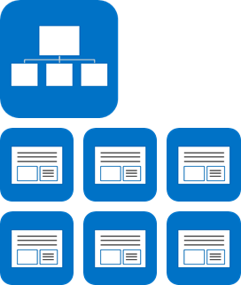
App Scoping
Web Scope
Can register and use resources in parent site, site collection
Tenant Scope
Can register start page, custom actions
Tenant Admins can filter-enable on sites
By Site Collection, Managed Path, Template Type
(SharePoint-hosted tenant-scope apps not available)
Notes:
Another consideration when building apps involves the scope of the app. Will the app be scoped to a SharePoint site (or a web) as a document library is, or will it be tenant scoped. Tenant scoped means that the app may contain data for multiple tenants (customers) and partition each experience per customer.
Tenant scoped apps can not reside in SharePoint… these types of apps can only be implemented as cloud apps.

Slide 24
Application Isolation
When apps are provisioned, new SPWeb (AppWeb) created within hosting SPWeb
Each app resides within it’s own SPWeb for isolation
Special DNS address configured by administrators
App SPWeb’s live in separate domain (DNS)
Each App hosted on it’s own unique URL because:
Blocks XSS: isolation to special SPWeb under special domain blocks cross site scripting
Enforces App Permissions: apps communicate with sites via CSOM / API & must be granted to do so
Notes:
When an app is installed, SharePoint creates a special SharePoint site (SPWeb) for the app. This site, called an AppWeb, is given it’s own top-level URL that is different from the hosting site. This unique URL enforces two things:
Blocking cross site scripting (XSS) – because the hosting site & the AppWeb are in different domains, browsers will block any script that tries to access resources in different domains.
Enforcing App Permissions – apps will only be allowed to access SharePoint sites if they have been granted access to do so and when they do, they can access it using the CSOM or OData APIs.

Slide 25
Obtaining Applications
Applications can be acquired multiple ways
Public Marketplace
Similar Windows Phone Marketplace
Subject to submission process & approval
App Catalog
Apps developed internally
Apps acquired and approved for internal use
Custom Deployment Process
Developers can use remote / local SharePoint & Windows Azure APIs to deploy apps with custom code
These APIs are restricted to the developer site for tooling scenarios
Notes:
Customers have multiple ways of obtaining apps. Developers can create apps and submit them to a public marketplace. These types of apps will be validated by Microsoft similar to how apps for the Windows Phone are validated. Customers can then acquire these apps and pay for them if they are not free.
Enterprises can also use a corporate catalog which is essentially a private marketplace for their deployment (or tenant in a hosted environment). Enterprise developers can deploy apps to their corporate catalog in order to distribute apps to SharePoint sites but not make them publically available.
Finally SharePoint contains APIs allowing developers to do a direct deployment of an app to SharePoint bypassing the marketplace. This is similar to what happens when apps are developed and tested using F5 debugging in Visual Studio.

Slide 26
Architecture
SharePoint contains minimal app components
Title, description, thumbnail
Permissions requested by application
Different hosting models to choose from:
SharePoint – uses SharePoint assets & logic runs in client
Cloud Hosted – logic runs outside of SharePoint (cloud)
Notes:
Developers are given the option to create two different types of apps that are fundamentally different from an architectural perspective. These two types of apps are SharePoint Hosted apps or Cloud Hosted apps. These two types of hosting models will be covered in other modules in this course.
Apps do share a few common things though. Within each app you will find an AppManfiest.xml file that will describe the app to SharePoint. This contains some basic metadata about the app (ID, title, description & thumbnail) as well as a list of all the permissions the app needs when it is installed.

Slide 27
App model architecture overview

Slide 28
App Model Type 1: SharePoint Hosted
SharePoint hosted apps wholly reside in SharePoint
Uses SharePoint artifacts (lists/libraries)
Business logic executes or on the client
HTML5
JavaScript
Notes:
A SharePoint hosted app is one where the business logic is implemented within the client (browser). These types of apps do not have any external dependencies nor do they use any server-side code but they can utilize some SharePoint artifacts such as lists and libraries for storing content.

Slide 29
SharePoint App Model: SharePoint Hosted
demo

Slide 30
App Model Type 2: Cloud Hosted
Cloud hosted apps primarily execute outside of SharePoint
May use SharePoint artifacts (lists/libraries)
Communicate via CSOM / REST
Granted permission to SharePoint via OAuth
Business logic lives & executes outside of SharePoint
On-Premise hosted web application
Windows Azure
3rd party host
Notes:
A cloud hosted SharePoint app is one where the business logic of the application runs not in SharePoint or in the client, but typically runs as some other infrastructure. For example, an app may run from as an ASP.NET MVC Web application hosted in Windows Azure. The app has a SharePoint footprint, but the bulk of the application runs outside of SharePoint.
Using some of the branding techniques, cloud apps can be made to look just like the hosting SharePoint AppWeb and utilize SharePoint artifacts that it was granted permission to access when it was installed.
Cloud hosted applications are not required to run just in Windows Azure, they can run in a local IIS server or even a server that isn’t on the Microsoft or .NET technology stack.

Slide 31
SharePoint App Model: Cloud Hosted
demo

Slide 32
Summary
Why Apps?
Introducing the new SharePoint 2013 App Model
App Model Architecture Overview
App Hosting Models
Development Process
App User Experience

Slide 33
Q&A

Slide 34

© 2012 Microsoft Corporation. All rights reserved. Microsoft, Windows, Windows Vista and other product names are or may be registered trademarks and/or trademarks in the U.S. and/or other countries.
The information herein is for informational purposes only and represents the current view of Microsoft Corporation as of the date of this presentation. Because Microsoft must respond to changing market conditions, it should not be interpreted to be a commitment on the part of Microsoft, and Microsoft cannot guarantee the accuracy of any information provided after the date of this presentation. MICROSOFT MAKES NO WARRANTIES, EXPRESS, IMPLIED OR STATUTORY, AS TO THE INFORMATION IN THIS PRESENTATION.

